Slide 1
Department of Computer Science
CS F364 – DESIGN AND ANALYSIS OF ALGORITHMS
LECTURE – QUICK SORT, SELECTION SORT
PORTIONS: As specified in handout and the contents taught in class. Class notes is must. Refer to the textbook as mentioned in handout
PLEASE NOTE THAT PPT IS JUST AN ADDITIONAL REFERENCE.

Slide 2
Topics- Lecture 4
Quick sort algorithm and analysis
Selection sort algorithm and analysis
Recursion Tree
Masters Theorem

Slide 3
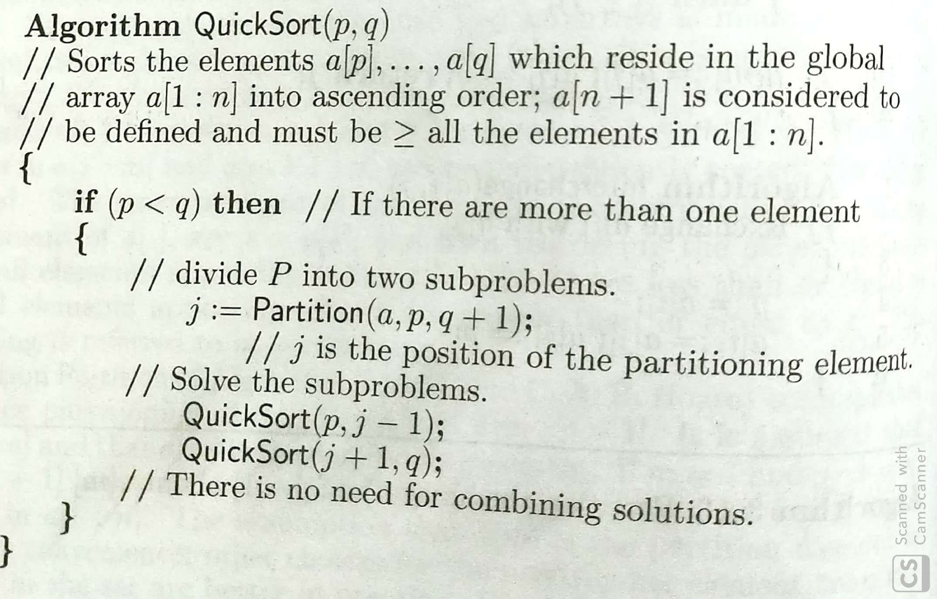
Quick Sort

Slide 4
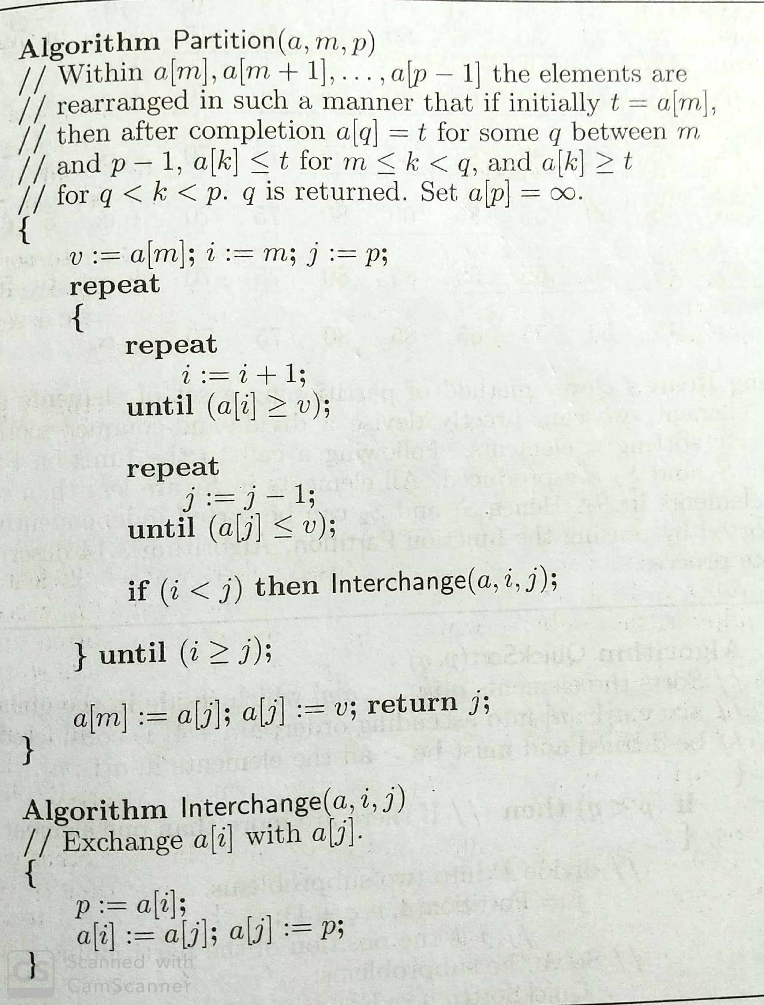
Quick Sort

Slide 5
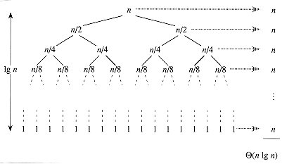
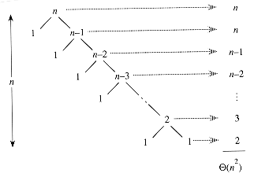
Quick sort Recursion tree

Slide 6
Selection Sort
In place sorting algorithm
selectionSort(int arr[], int i, int n)
{
int min = i;
for (int j = i + 1; j < n; j++)
{
if (arr[j] < arr[min])
min = j;
}
swap(arr, min, i);
if (i + 1 < n) {
selectionSort(arr, i + 1, n);
}
}

Slide 7
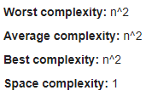

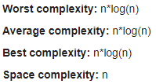
Selection Sort Quick Sort Merge Sort

Slide 8
Recursion Tree Example
T(n)=3T(n/3)+n^2
T(n)=4T(n/2)+n
T(n)=4T(n/2)+n^2

Slide 9
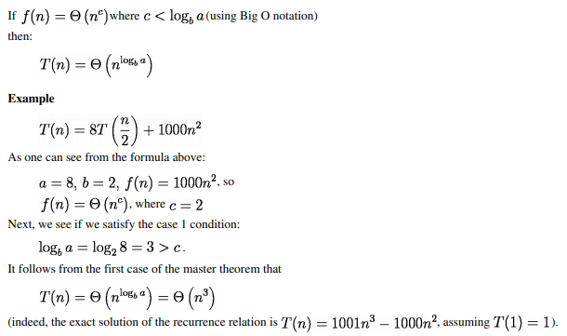
Masters Theorem - Case 1

Slide 10
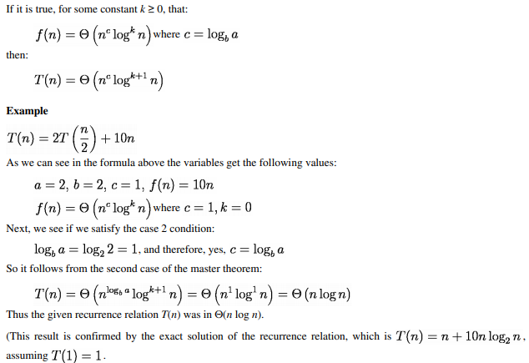
Masters Theorem - Case 2

Slide 11
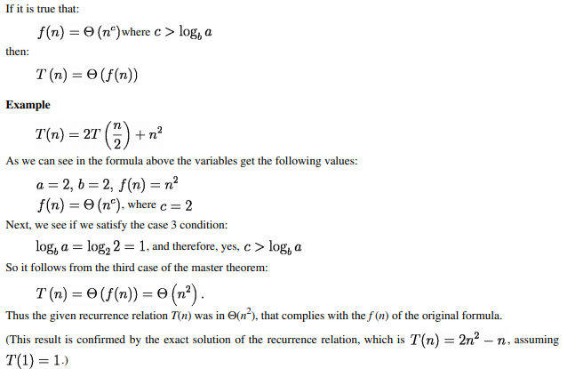
Masters Theorem - Case 3

Slide 12
THANK YOU

